Slide 1
Kubernetes

Slide 2
What is Orchestration?
Orchestration is the automated configuration, management, and coordination of computer systems, applications, and services.
A number of tools exist for automation of server configuration and management, including Ansible, Puppet, Salt, Terraform, and AWS CloudFormation.
Orchestration helps IT to more easily manage complex tasks and workflows.

Slide 3
Why Orchestration?
IT teams must manage many servers and applications, but doing so manually isn’t a scalable strategy.
The more complex an IT system, the more complex managing all the moving parts can become.
The need to combine multiple automated tasks and their configurations across groups of systems or machines increases. That’s where orchestration can help.

Slide 4
Automation vs Orchestration
Automation and orchestration are different, but related concepts.
Automation helps make your business more efficient by reducing or replacing human interaction with IT systems and instead using software to perform tasks in order to reduce cost, complexity, and errors.
In general, automation refers to automating a single task.
This is different from orchestration, which is how you can automate a process or workflow that involves many steps across multiple disparate systems.
When you start by building automation into your processes, you can then orchestrate them to run automatically.
IT orchestration also helps you to streamline and optimize frequently occurring processes and workflows, which can support a DevOps approach and help your team deploy applications more quickly.

Slide 5
What Is Kubernetes?
Kubernetes is an open-source container management (orchestration) tool.
It’s container management responsibilities include container deployment, scaling & descaling of containers & container load balancing.

Slide 6
Why Use Kubernetes?
Companies out there maybe using Docker or Rocket or maybe simply Linux containers for containerizing their applications.
But, whatever it is, they use it on a massive scale ?
They don’t stop at using 1 or 2 containers in Prod. But rather, 10’s or 100’s of containers for load balancing the traffic and ensuring high availability.
Keep in mind that, as the traffic increases, they even have to scale up the number of containers to service the ‘n’ no of requests that come in every second. And, they have to also scale down the containers when the demand is less.
That is why, the need for container management tools is imminent.
Both Docker Swarm and Kubernetes are popular tools for Container management and orchestration.
Kubernetes for the reason simply being: Auto-scaling of containers based on traffic needs.

Slide 7
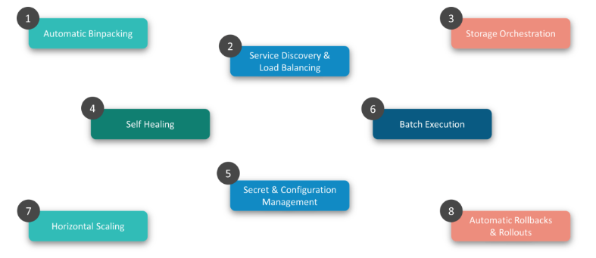
Features Of Kubernetes

Slide 8
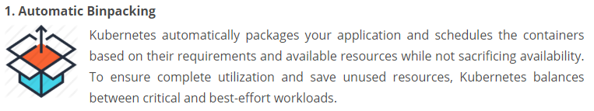
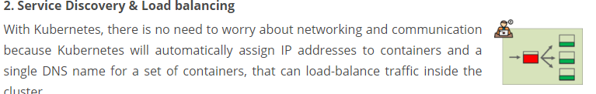
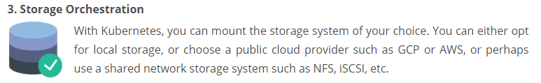
Features Of Kubernetes

Slide 9
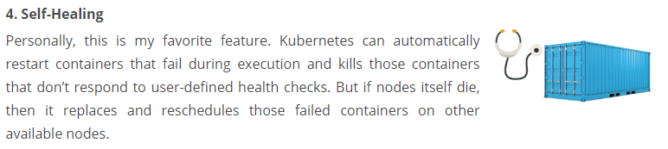
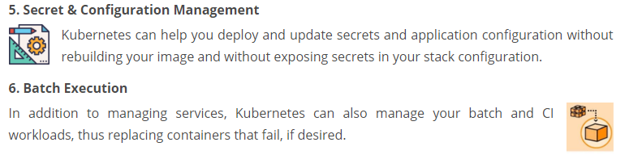
Features Of Kubernetes

Slide 10
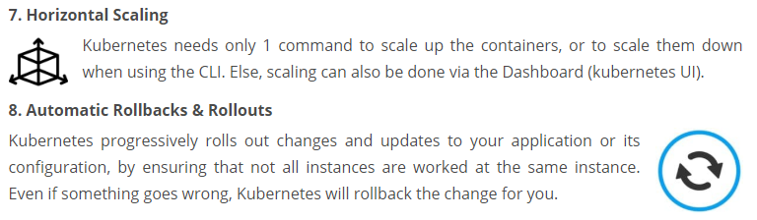
Features Of Kubernetes

Slide 11
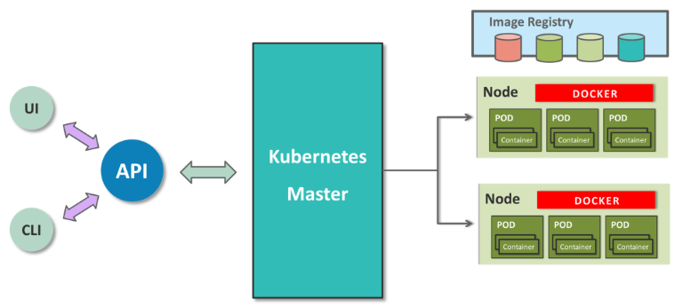
Kubernetes Architecture

Slide 12
Kubernetes Architecture
Kubernetes implements a cluster computing background, everything works from inside a Kubernetes Cluster.
This cluster is hosted by one node acting as the ‘master’ of the cluster and other nodes as ‘nodes’ which do the actual ‘containerization‘.
Master controls the cluster and the nodes in it.
It ensures the execution only happens in nodes and coordinates the act.
Nodes host the containers,
in-fact these Containers are grouped logically to form Pods.
Each node can run multiple such Pods, which are a group of containers, that interact with each other, for a deployment.
Replication Controller is Master’s resource to ensure that the requested no. of pods are always running on nodes.
Service is an object on Master that provides load balancing across a replicated group of Pods.

Slide 13
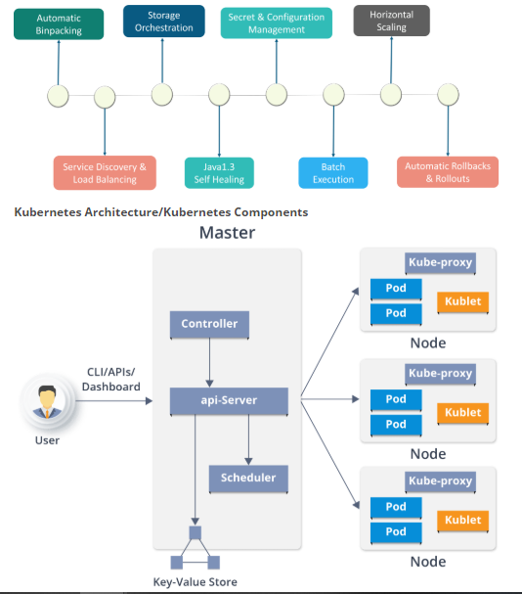
Kubernetes Architecture
Kubernetes Architecture
has the following main components:
Master nodes
Worker/Slave nodes
Distributed key-value store

Slide 14
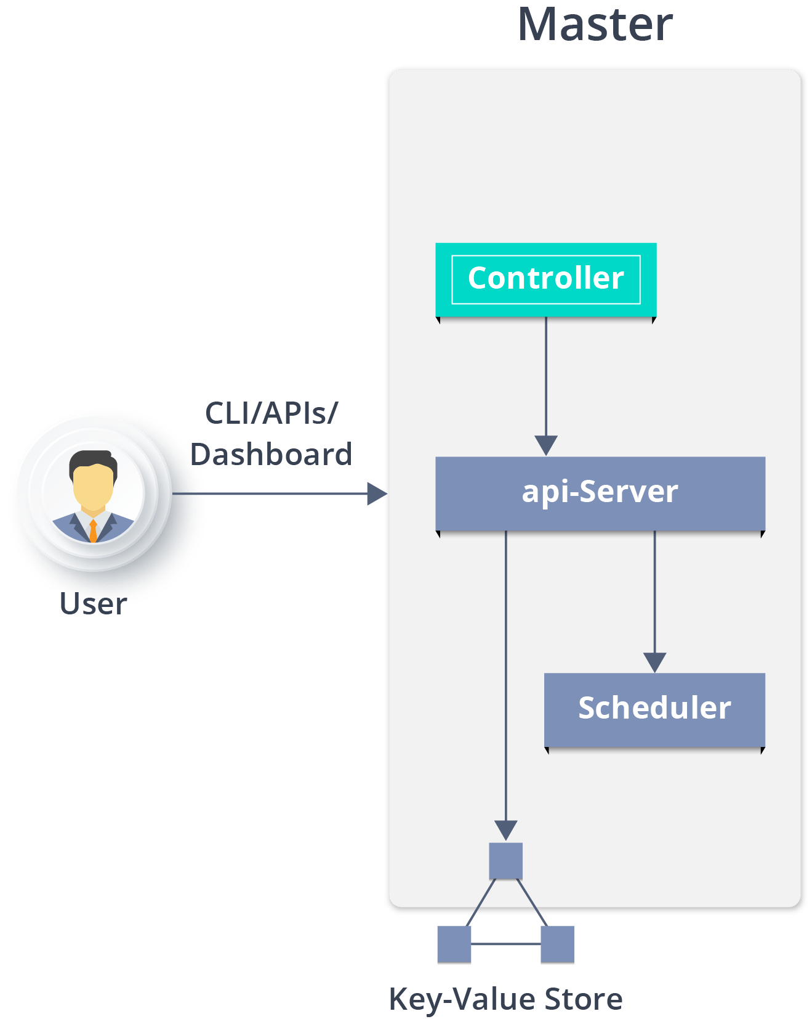
Kubernetes Architecture
Master Node
Master Node - is the entry point for all administrative tasks which is responsible for managing the Kubernetes cluster.
There can be more than one master node in the cluster to check for fault tolerance.

Slide 15
Kubernetes Architecture
API server:
Performs all the administrative tasks through the API server within the master node.
In this REST commands are sent to the API server which validates and processes the requests.
After requesting, the resulting state of the cluster is stored in the distributed key-value store.
Scheduler:
The scheduler schedules the tasks to slave nodes. It stores the resource usage information for each slave node.
It schedules the work in the form of Pods and Services.

Slide 16
Kubernetes Architecture
Controller manager:
Also known as controllers.
It is a daemon which regulates the Kubernetes cluster which manages the different non-terminating control loops.
It also performs lifecycle functions such as:
namespace creation and lifecycle
event garbage collection
terminated-pod garbage collection
cascading-deletion garbage collection
node garbage collection etc.
Basically, a controller watches the desired state of the objects it manages and watches their current state through the API server.

Slide 17
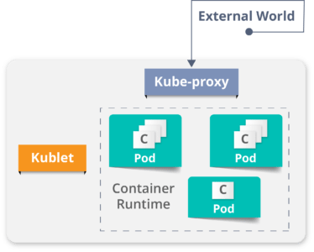
Kubernetes Architecture
Worker Node (formerly minions)
- is a physical server or you can say a VM which runs the applications using Pods (a pod scheduling unit) which is controlled by the master node.
On a physical server (worker/slave node), pods are scheduled.
For accessing the applications from the external world, we connect to nodes.
Container runtime:
To run and manage a container’s lifecycle, we need a container runtime on the worker node.
Sometimes, Docker is also referred to as a container runtime, but to be precise, Docker is a platform which uses containers as a container runtime.

Slide 19
Setting Up Kubernetes on Windows
Install Cygwin
Install MiniKube
Install Kubectl
Install Oracle Virtual box

Slide 20
Setting Up Kubernetes (K8s) on Windows
Install Cygwin
The Windows command prompt really sucks when it comes to using K8s.
The Linux terminal provides a fantastic user experience while running Docker commands or K8s commands.
On windows, you can get similar kind of user experience with Cygwin. Install Cygwin by following the steps listed on its website.
https://cygwin.com/install.html

Slide 21
Setting Up Kubernetes (K8s) on Windows
Install kubectl
kubectl is a Kubernetes command-line tool, and it is used to deploy and manage applications on Kubernetes.
kubectl provides features to inspect cluster resources, create, delete, and update components, get the status of K8s clusters, and deploy and run applications in K8s.
Here are the steps to set up a kubectl on Windows:
Download the kubectl.exe using a link and save the file in any folder on windows file system.
https://kubernetes.io/docs/tasks/tools/install-kubectl/
Add the kubectl.exe folder location in path variable - “Advanced System Settings -> Advanced -> Environment Variables -> Path”.
For example, if you have saved file to C:/kube then add this folder path to the path variable.
Open a command prompt and type kubectl and you should see all commands supported by kubectl
Command : kubectl

Slide 22
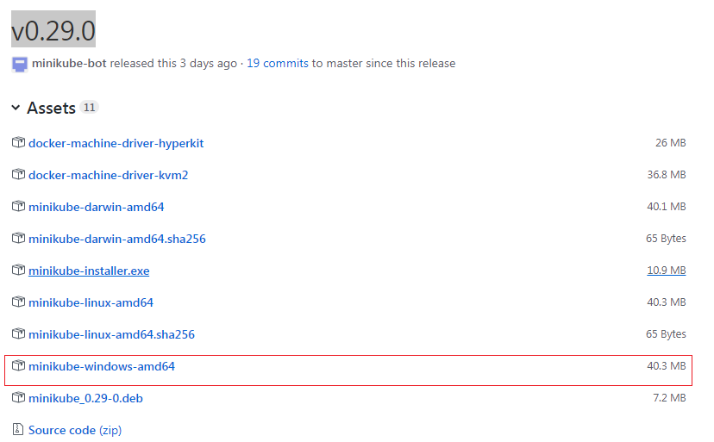
Setting Up Kubernetes (K8s) on Windows
Install minikube
VT-x or AMD-v virtualization must be enabled in your computer’s BIOS.
Install the virtualization platform such as Virtualbox or KVM. You are not really required to configure the image.
Download the minikube-windows-amd64 file from here.
https://github.com/kubernetes/minikube/releases
The current version of minikube is v0.29.0.
Rename the file to minikube.exe. Note the extension “exe” is added.
Add this folder path location in path variable: “Advanced System Settings -> Advanced -> Environment Variables -> Path.” For example, if you have saved the file to C:/kube then add this folder path to the path variable.
Open the command prompt and fire a command minikube and you should see all the commands supported by minikube.
Command: minikube

Slide 23
Minikube : to Create a Cluster
Minikube is a lightweight Kubernetes implementation that creates a VM on your local machine and deploys a simple cluster containing only one node.
Minikube is available for Linux, macOS, and Windows systems.
The Minikube CLI provides basic bootstrapping operations for working with your cluster, including start, stop, status, and delete.

Slide 24
Minikube to Create a Cluster
Kubernetes Clusters
Kubernetes coordinates a highly available cluster of computers that are connected to work as a single unit.
The abstractions in Kubernetes allow you to deploy containerized applications to a cluster without tying them specifically to individual machines.

Slide 25
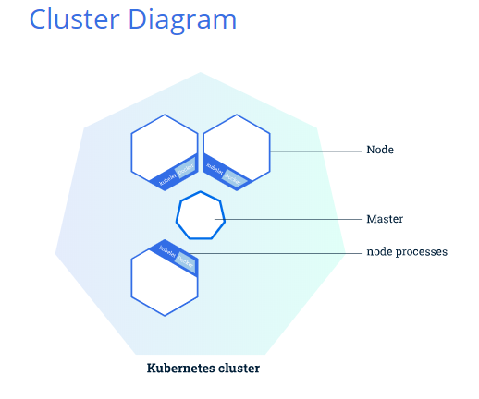
Minikube to Create a Cluster
Kubernetes Clusters
A Kubernetes cluster consists of two types of resources:
The Master coordinates the cluster
Nodes are the workers that run applications

Slide 26
Minikube to Create a Cluster
The Master is responsible for managing the cluster.
The master coordinates all activities in your cluster, such as:
scheduling applications
maintaining applications' desired state
scaling applications
rolling out new updates.

Slide 27
Minikube to Create a Cluster
A node is a VM or a physical computer that serves as a worker machine in a Kubernetes cluster.
Each node has a Kubelet, which is an agent for managing the node and communicating with the Kubernetes master.
The node should also have tools for handling container operations, such as Docker or rkt.
A Kubernetes cluster that handles production traffic should have a minimum of three nodes.

Slide 28
Minikube to Create a Cluster
A Kubernetes cluster can be deployed on either physical or virtual machines.
To get started with Kubernetes development, you can use Minikube.
Minikube is a lightweight Kubernetes implementation that creates a VM on your local machine and deploys a simple cluster containing only one node.
Minikube is available for Linux, macOS, and Windows systems.
The Minikube CLI provides basic bootstrapping operations for working with your cluster, including start, stop, status, and delete.

Slide 29
Minikube to Create a Cluster
Online URL
https://kubernetes.io/docs/tutorials/kubernetes-basics/create-cluster/cluster-interactive/
Cluster up and running
To check that installed minikube is properly or not :
minikube version
Start the cluster, by running command:
minikube start
Now have a running Kubernetes cluster in terminal.
Minikube started a virtual machine for us, and a Kubernetes cluster is now running in that VM.

Slide 30
Minikube to Create a Cluster
Cluster version
To interact with Kubernetes ,use the command line interface, kubectl.
To check if kubectl is installed you can run the kubectl version command:
kubectl version

Slide 31
Minikube to Create a Cluster
Cluster details
To get kubectl cluster-info:
kubectl cluster-info
To view the nodes in the cluster, run the kubectl get nodes command:
kubectl get nodes
This command shows all nodes that can be used to host our applications.
Now may be there is only one node, and its status is ready (it is ready to accept applications for deployment).

Slide 32
Using kubectl to Create a Deployment
Kubernetes Deployments
Once you have a running Kubernetes cluster, you can deploy your containerized applications on top of it.
To do so, you create a Kubernetes Deployment configuration.
The Deployment instructs Kubernetes how to create and update instances of your application.
Once you've created a Deployment, the Kubernetes master schedules the application instances included in that Deployment to run on individual Nodes in the cluster.

Slide 33
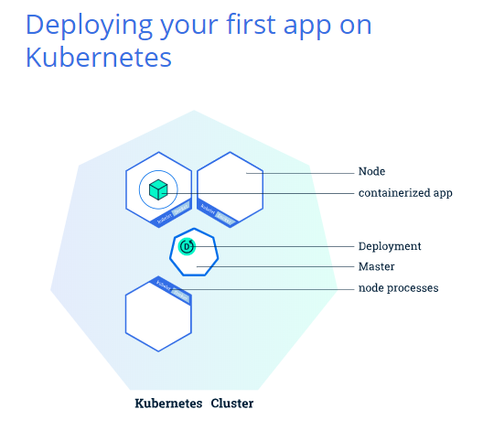
Deploying an App
A Pod is the basic execution unit of a Kubernetes application.
Each Pod represents a part of a workload that is running on your cluster.
To deploy our first app on Kubernetes with the kubectl create deployment command.
We need to provide the deployment name and app image location (include the full repository url for images hosted outside Docker hub).

Slide 34
Viewing Pods and Nodes
Kubernetes Pods
When you created a Deployment, Kubernetes created a Pod to host your application instance.
A Pod is a Kubernetes abstraction that represents a group of one or more application containers (such as Docker or rkt), and some shared resources for those containers.
Those resources include:
Shared storage as Volumes
Networking as a unique cluster IP address
Information about how to run each container, such as the container image version or specific ports to use

Slide 35
Deploying an App
To list deployments use the get deployments command:
kubectl get deployments
To remove any existing deployments , use
kubectl delete deployments <deploymentname>
We see that there is 1 deployment running a single instance of your app.
The instance is running inside a Docker container on your node.

Slide 36
Viewing Pods and Nodes
Nodes
A Pod always runs on a Node.
A Node is a worker machine in Kubernetes and may be either a virtual or a physical machine, depending on the cluster.
Each Node is managed by the Master.
A Node can have multiple pods and the Kubernetes master automatically handles scheduling the pods across the Nodes in the cluster.

Slide 37
Kubernetes Services
A Service in Kubernetes is an abstraction which defines a logical set of Pods and a policy by which to access them.
Services enable a loose coupling between dependent Pods.
A Service is defined using YAML or JSON, like all Kubernetes objects.
The set of Pods targeted by a Service is usually determined by a LabelSelector.

Slide 38
Kubernetes Services
Although each Pod has a unique IP address, those IPs are not exposed outside the cluster without a Service.
Services allow your applications to receive traffic.
Services can be exposed in different ways by specifying a type in the ServiceSpec:
ClusterIP (default) - Exposes the Service on an internal IP in the cluster. This type makes the Service only reachable from within the cluster.
NodePort - Exposes the Service on the same port of each selected Node in the cluster using NAT. Makes a Service accessible from outside the cluster using <NodeIP>:<NodePort>. Superset of ClusterIP.
LoadBalancer - Creates an external load balancer in the current cloud (if supported) and assigns a fixed, external IP to the Service. Superset of NodePort.
ExternalName - Exposes the Service using an arbitrary name (specified by externalName in the spec) by returning a CNAME record with the name. No proxy is used. This type requires v1.7 or higher of kube-dns.

Slide 39
kubectl commands
kubectl get - list resources
kubectl describe - show detailed information about a resource
kubectl logs - print the logs from a container in a pod
kubectl exec - execute a command on a container in a pod
To delete the pod you have created:
kubectl get pod
kubectl delete pod <podname>
You can use these commands to see when applications were deployed, what their current statuses are, where they are running and what their configurations are.

Slide 40
Tutorial to run a sample app on Kubernetes using Minikube
If you installed Minikube locally, run :
minikube start
check :
minikube status
Open the Kubernetes dashboard in a browser:
minikube dashboard

Slide 41
Tutorial to run a sample app on Kubernetes using Minikube
Create a Deployment
--------------------------------
A Kubernetes Pod is a group of one or more Containers, tied together for the purposes of administration and networking.
The Pod here has only one Container.
A Kubernetes Deployment checks on the health of your Pod and restarts the Pod's Container if it terminates.
Use the kubectl create command to create a Deployment that manages a Pod.
The Pod runs a Container based on the provided Docker image.
Command:
kubectl create deployment hello-node --image=k8s.gcr.io/echoserver:1.4

Slide 42
Tutorial to run a sample app on Kubernetes using Minikube
View the Deployment: kubectl get deployments
The output is similar to:
NAME READY UP-TO-DATE AVAILABLE AGE
hello-node 1/1 1 1 1m
View the Pod: kubectl get pods
The output is similar to:
NAME READY STATUS RESTARTS AGE
hello-node-5f76cf6ccf-br9b5 1/1 Running 0 1m
detail View the Pod: kubectl get pods -o wide
View cluster events: kubectl get events
View the kubectl configuration: kubectl config view

Slide 43
Tutorial to run a sample app on Kubernetes using Minikube
Create a Service
----------------------
By default, the Pod is only accessible by its internal IP address within the Kubernetes cluster.
To make the hello-node Container accessible from outside the Kubernetes virtual network, you have to expose the Pod as a Kubernetes Service.
Expose the Pod to the public internet using the kubectl expose command:
kubectl expose deployment hello-node --type=LoadBalancer --port=8080
**The --type=LoadBalancer flag indicates that you want to expose your Service outside of the cluster.

Slide 44
Tutorial to run a sample app on Kubernetes using Minikube
View the Service you just created: kubectl get services
On cloud providers that support load balancers, an external IP address would be provisioned to access the Service.
On Minikube, the LoadBalancer type makes the Service accessible through the minikube service command.
Run the following command: minikube service hello-node
minikube service hello-node
| NAMESPACE | NAME | TARGET PORT | URL |
| default | hello-node | 8080 | http://192.168.99.102:31905 |
* Opening service default/hello-node in default browser...: http://192.168.99.102:31905/
To get the url only , command :
minikube service hello-node --url

Slide 45
Tutorial to run a sample app on Kubernetes using Minikube
Clean up
Now you can clean up the resources you created in your cluster:
kubectl delete service hello-node
kubectl delete deployment hello-node
Optionally, stop the Minikube virtual machine (VM):
minikube stop
Optionally, delete the Minikube VM:
minikube delete

